Slide 1
Status reporting tool
Team Members:
Uma Kalyani,
Balaji,
Himakar,
Tirumalesh,
Shiva Kumar

Slide 2
index
Modules description
Use-cases
tables

Slide 3
modules

Slide 4
EMPLOYEE
Initially Employee logs in with company’s credentials
Employee uses Status Report Tool to provide daily status report to Manager
Employee can view his/her previous status according to the dates provided by him/her
Employee details are added or made inactive by the manager

Slide 5
MANAGER
Manager receives the all the status reports from the employees.
He can view the status reports of the employees according to the date or employee id.
He can add or make employee’s credentials inactive.

Slide 6
Use CASE DIAGRAMS

Slide 7
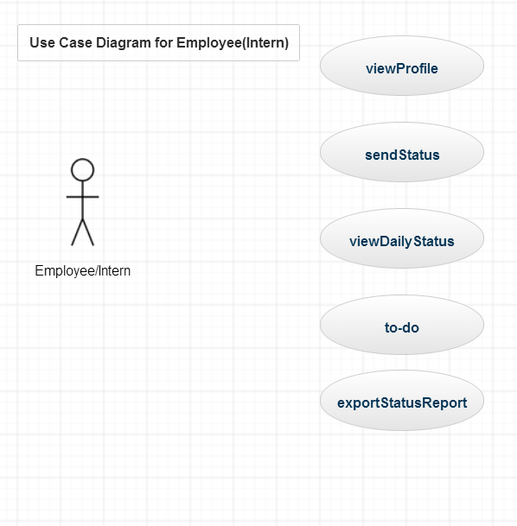
Use case | Description
viewProfile | Employee can view/update(only authenticated fields) his own profile
sendStatus | Can send his activity status to his manager
viewDailyStatus | Can view his status daily wise and monthly wise
To-do | Can add some personal notes like to-do’s on his dashboard
exportStatusReport | Can export his activity report both monthly wise

Slide 8
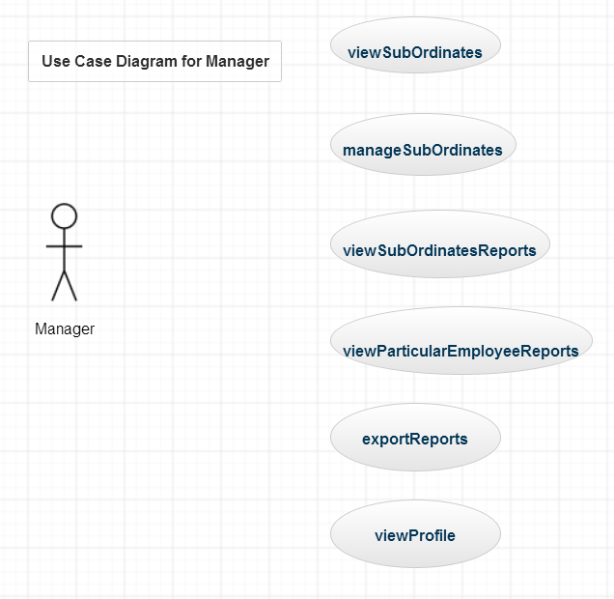
Use case | Description
viewSubOrdinates | Can access his subordinate’s profiles
manageSubOrdinates | Can add/deactivate subordinate
viewSubOrdinatesReports | Can view the activity/task status sent by all employee on particular day
viewParticularEmployeeReports | Can view the particular employee’s reports from the
exportReports | Can export the activity reports as excel file
viewProfile | Can view his own profile
employeeRemarks | Can add personal remarks on every employee
employeeRemarks

Slide 9
EMPLOYEE TABLE
FIELD NAME | DATATYPE | CONSTRAINTS
EMP_ID | VARCHAR(10)
EMP_NAME | VARCHAR(10)
PHONE_NO | NUMBER(10)
EMAIL_ID | VARCHAR(20) | PRIMARY KEY
PASSWORD | VARCHAR(15)
DEPT | VARCHAR(20)

Slide 10
MANAGER TABLE
FIELD NAME | DATATYPE | CONSTRAINTS
MAN_ID | VARCHAR(10)
MAN_NAME | VARCHAR(10)
PHONE_NO | NUMBER(10)
EMAIL | VARCHAR(20) | PRIMARY KEY
DEPT | VARCHAR(20)

Slide 11
STATUS TABLE
FIELD NAME | DATA TYPE | CONSTRAINTS
EMP_ID | VARCHAR(10)
EMP_NAME | VARCHAR(10)
EMAIL | VARCHAR(20)
DATE | DATE
STATUS | BLOB

Slide 12
REMARKS TABLE
FIELD NAME | DATA TYPE | CONSTRAINTS
EMP_ID | VARCHAR(10)
EMAIL | VARCHAR(20) | FOREIGN KEY
NAME | VARCHAR(20)
MAN_ID | VARCHAR(10) | FOREIGN KEY
REMARKS | VARCHAR(1MB)
DATE | DATE

Slide 13
Any questions??

Slide 14
Thank you

